Slide 1
ReasonED.io:
Design
Team Crystal
Emily Louk
Alysha Morgan
Areeb Nabi
June Troyer
Dakota Dawe
Nolan Marchione
Devan Hill
CS 410 Professional Workforce Development Ⅰ
12/11/23
Notes:
Good Afternoon everyone, we are Team Crystal and we will be presenting the Feasibility and Design details for our software solution: ReasonED

Slide 2
Table of Contents
3 Vision
4 Team Members
6 Terms
8 Background
11 Statistics
13 Problem Statement
14 Problem/Characteristics
15 Current Process Flow
16 Solution/Features
22 Customers/End Users
23 Solution Process Flow
24 Competition
26 Risk Analysis
29 MFCD
30 Work Breakdown
32 Algorithms
39 Database Schema
41 RWP vs. Prototype
42 Software/Hardware
43 Conclusion
45 References
CS 410
ReasonED.io | Design
Notes:
Here is a quick overview of the slide sequence we're gonna follow today. We'll go over some important terms to make sure everyone's on the same page, explain the background context of our problem, pinpoint the problem itself, and then introduce our solution and the practicalities of it.

Slide 3

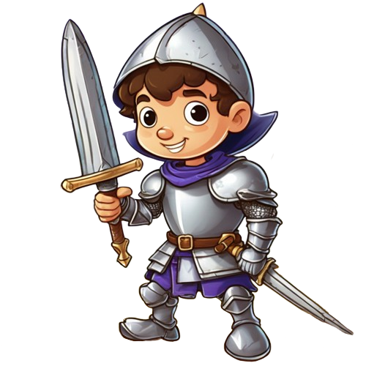


Vision
Cultivate Logical Fallacy Skills Throughout K-12 and Adulthood
Game-Based Learning Website
Engaging Games For Every Age
Make Critical Reasoning Education Fun & Accessible
CS 410
ReasonED.io | Design
Notes:
We envision a future where critical reasoning, specifically logical fallacy identification, becomes a second nature skill, starting from the earliest years of education.
Our product is a game-based learning website that provides logical fallacy education through engaging video games where logical fallacies are personified as fun characters, and through game difficulties that are curated for every grade level.
We want to create a world where children and adults alike can learn to recognize flawed reasoning not as a chore, but as a pastime.
ReasonED aims to transform logical fallacy education for students and educators by making it fun, accessible, and a lifelong habit.

Slide 4


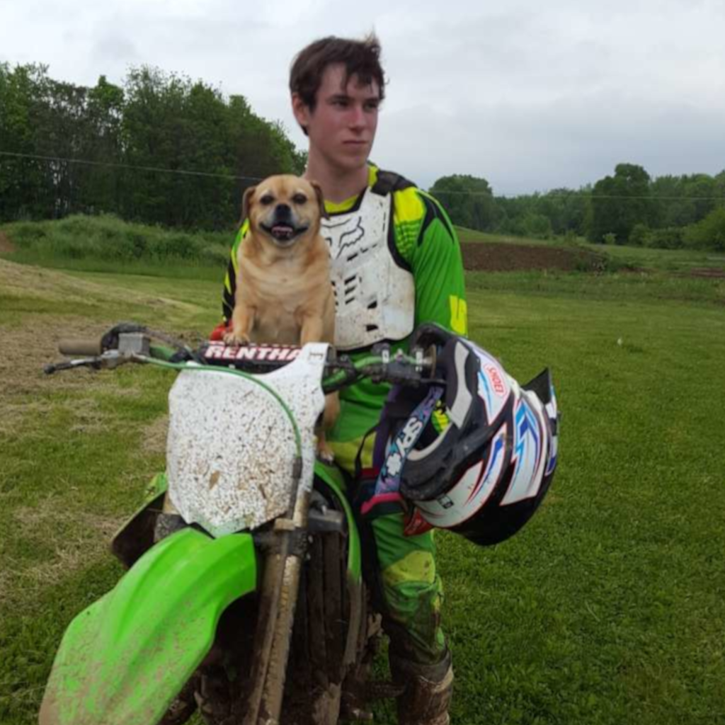


Biographies
Emily Louk
Dakota Dawe
Areeb Nabi
June Troyer
Emily is a senior undergraduate at ODU. She has an Associate degree in Information Systems and will pursue software engineering after earning her B.S.C.S.. At ODU, she has interned with the Game Studies program as a programmer and participated in a research project. She is interested in developing educational tools, video games, and mobile apps.
Dakota is still finishing his Associates degree at LFCC while working through the remaining courses at ODU for his Bachelors. Dakota is currently working as a games programmer selling plugins on the Unreal Engine marketplace as well as a contract programmer for Small Indie Company developing their upcoming title “We The People”.
Areeb is a senior at Old Dominion University pursuing his undergraduate degree in Computer Science. He recently completed a 10-week summer internship with Automatic Data Processing (ADP), honing his skills as a Full-Stack Developer. Areeb specifically enjoys front-end development, and working with JavaScript libraries such as React, Express, and Node.js.
June is a senior Computer Science undergraduate at ODU in the linked Master’s program. She has an associate degree in Science from Piedmont Virginia Community College. She enjoys helping others explore new topics and improve their skills and reasoning.
CS 410
ReasonED.io | Design
Notes:
Before we dive in we'll take a quick minute to introduce ourselves. [Each member will briefly introduce themselves]

Slide 5



Biographies cont.
Alysha Morgan
Nolan Marchione
Devan Hill
Alysha is a undergraduate Senior at Old Dominion University, currently working towards her Bachelor’s degree in Computer Science with a minor in Cybersecurity. With a deep passion for technology, she is actively honing her skills to become a software engineer.
Nolan is an undergraduate senior at Old Dominion University, aiming for a Bachelor’s degree in Computer Science. He enjoys listening to music, and is interested in using his skills to develop video games and open-source software tools.
Devan is an undergraduate senior at Old Dominion University for a Bachelor’s degree in Computer Science. He enjoys learning different kinds of technology. He wants to write programs and develop video games.
CS 410
ReasonED.io | Design
Notes:
[Each member will briefly introduce themselves]

Slide 6

Terms
Confirmation Bias - A cognitive bias that involves seeking, interpreting, and remembering information that confirms one’s preconceptions (American Psychological Association n.d.).
Critical Thinking - The ability to think clearly and rationally, understanding the logical connection between ideas and the ability to make reasoned judgements (American Psychological Association n.d.).
Fact-Checking - The process of verifying the accuracy of claims made in public discourse and journalism (Cambridge English Dictionary n.d.).
False Dilemma - A fallacy that presents a limited set of options as the only possible choices when there may be other alternatives (Excelsior OWL n.d.).
Logical Fallacy - An error in reasoning or a flawed argument that can make an argument appear valid when it is not (Nikolopoulou, 2023).
CS 410
ReasonED.io | Design
Notes:
As you explore our software, you’ll encounter these terms frequently, and mastering their meanings is key to becoming a informed consumer of digital content.
Let’s begin by introducing the glossary of important terms our software addresses:
Confirmation Bias
This is a cognitive bias that occurs when individuals seek, interpret, and remember information that aligns with their existing beliefs.
In our context, it’s an important concept because it relates to how people tend to consume information online, often gravitating toward sources that confirm their existing views.
Critical Thinking
Critical thinking is a fundamental skill that involves clear and rational thought. It’s the ability to understand the logical connections between ideas and make reasoned judgements.
In our software, we aim to enhance critical thinking skills, helping users identify logical fallacies and improve their overall decision-making abilities.
Fact-Checking
Fact-checking is the process of verifying the accuracy of claims made in public discourse and journalism.
It’s a crucial part of our software’s mission, as it empowers users to know the difference between accurate and false information by providing them with the tools to fact-check claims effectively.
False Dilemma
A false dilemma is a logical fallacy that presents a limited set of options as the only possible choices when other alternatives may exist.
Logical Fallacy
This term refers to errors in reasoning or flawed arguments that can make an argument seem valid when it is not. In the context of our software, understanding logical fallacies is crucial for users to discern between sound and unsound arguments.

Slide 7
Terms
cont.
Misinformation - False or inaccurate information shared, often unintentionally, without the intent to deceive (Dictionary.com n.d.).
Disinformation - False information deliberately spread to deceive or mislead others (Dictionary.com n.d.).
Slippery Slope - A fallacy that suggests one small step will inevitably lead to a chain of related events, often with exaggerated consequences (Excelsior OWL n.d.).
Straw Man Argument - A fallacy that involves misrepresenting an opponent’s argument to make it easier to attack and refute (Excelsior OWL n.d.).
CS 410
ReasonED.io | Design
Notes:
Misinformation
False or inaccurate information shared without the intent to deceive.
Disinformation
False information deliberately spread to deceive or mislead others.
Slippery Slope
A fallacy that suggests one small step will inevitably lead to a chain of related events, often with exaggerated consequences.
Straw Man Argument
This fallacy involves misrepresenting an opponent’s argument to make it easier to attack and refute.
So, with our building blocks out of the way we can continue on with our background.

Slide 8

Background
In the digital age, the ubiquity of the Internet has transformed the way we access, consume, and interact with information.
The online world serves as an expansive repository of knowledge, but it is not immune to misinformation and flawed reasoning (Wardle and Derakhshan, 2017).
CS 410
ReasonED.io | Design
Notes:
In this digital era, the Internet has become an essential tool for accessing and engaging with an immense pool of information.
And, it has transformed the way we acquire knowledge, interact with content, and participate in online discussions.
However, this vast online landscape is not immune to problems, and one of the key issues we face is the prevalence of logical fallacies.
In 2017, researchers from the council of europe discovered how misinformation and flawed reasoning is perpetuated by logical fallacies
And they often lead to real-life consequences in social, health, or political fields.

Slide 9

Background cont.
Logical fallacies, such as straw man arguments, false dilemmas, slippery slopes, and others, persist in online content, undermining the quality of discussions and the credibility of information distribution.
Fallacy
From the latin root fallac, which means to deceive (Etymology n.d.).
CS 410
ReasonED.io | Design
Notes:
These fallacies come in various forms, including strawman arguments, false dilemmas, slippery slopes, and many others.
They are deceptive tactics used within arguments to manipulate the structure of reasoning.
Fallacies diminish the quality of discussions and raises doubts about the credibility of information shared online.
Whether if it's through articles, podcasts, and the like.
Unlike blatant false information, which can be fact-checked and addressed directly, fallacies are often well-disguised within seemingly plausible arguments, making them difficult to discern.
And as we’ll explore in the next slide, they aren’t always easy to spot.

Slide 10
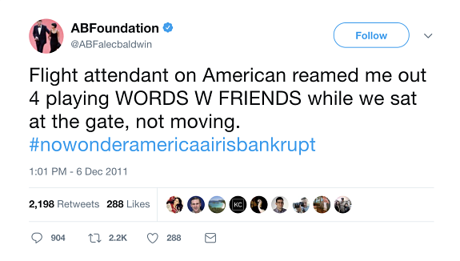

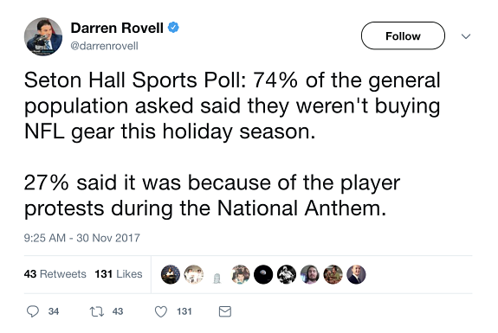
Background - Examples
1
3
In a blog post by M. Hope Echales (2017), the author discusses various Twitter posts related to LSAT preparation. @ABFalecbaldwin, @darrenrovell, and @bobatl, were all topics of the discussion.
2
CS 410
ReasonED.io | Design
Notes:
Twitter images from -> https://blog.blueprintprep.com/lsat/identifying-flaws-in-your-twitter-feed-a-new-frontier-in-lsat-preparation/
Here, three different Twitter posts serve as examples of logical fallacies often encountered online that we would not initially think harmful.
1st Post – Causation Fallacy (Post Hoc, Ergo Propter Hoc)
This post illustrates a causation fallacy, specifically known as “post hoc, ergo propter hoc”, which means “after this, therefore because of this.”
It’s when someone assumes that because one event followed another, the first event caused the second, in the absence of logical evidence.
In this case, the post is suggesting a connection between playing Words with Friends at the gate and the financial struggles of American Airlines, although there is no logical basis for such a claim.
2nd Post – Sampling Fallacy
In this post, we encounter a sampling fallacy, which arises when the studied sample does not accurately represent the entire population, leading to potentially inaccurate results.
In this case, the statement claims that 74% of the general population is not buying NFL gear this holiday season, meaning that it implies that the remaining 26% are considering such purchases. However, this assumption may not hold true for the entire population as it depends on…
1. How the sample was selected
2. Whether it accurately represents the opinions of the entire population.
3rd Post – Absence of Evidence Fallacy
This post represents an absence of evidence fallacy. This person is suggesting that if the visible cities in the background don’t show the Earth’s curvature, then the Earth must be flat.
One piece of evidence, or the lack thereof, does not conclusively prove or disprove a claim, like whether the Earth is round or flat.
Now, Dakota will discuss some statistics related to our problem.

Slide 11
Statistics
86% of 4th-grade teachers expressed a substantial emphasis on deductive reasoning (Bouygues, 2022).
86
The above figure dwindled to a mere 39% among 8th-grade teachers when expressing the same sentiment (Bouygues, 2022).
39
50% of teachers indicated that they face challenges in allocating time to teach critical thinking skills effectively (Critical Thinking Teacher Survey 2019).
50
Just 21% of teachers agreed that they possess all the necessary resources to cultivate these skills (Critical Thinking Teacher Survey 2019).
21
CS 410
ReasonED.io | Design
Notes:
Resources:
https://nces.ed.gov/nationsreportcard/about/
https://www.forbes.com/sites/helenleebouygues/2022/08/17/critical-skills-not-emphasized-by-most-middle-school-teachers/?sh=4a0a97452ee4
https://reboot-foundation.org/wp-content/uploads/2022/07/Reboot-White-Paper_NAEP-5.pdf
https://www.cambridge.org/us/cambridgeenglish/catalog/skills/unlock-2nd-edition/product-details/teaching-critical-thinking?utm_source=wobl&utm_medium=blog&utm_content=woblcontent&utm_campaign=unlock
In this slide, we aim to connect the significance of students having low critical thinking skills to their ability to identify logical fallacies.
According to a recent report titled “Teaching Critical Thinking in K-12” there are inconsistencies in the instruction of critical thinking across the U.S.
What’s noteworthy is that these inconsistencies tend to worsen as students progress through their academic journey as we can see with our first two figures.
Among 4th-grade teachers, 86% emphasized on teaching deductive reasoning, which sounds good.
But this figure sharply declines to a mere 39% among 8th-grade teachers when expressing the same sentiment.
So, there is clearly a decline in the emphasis on critical thinking in our education system.
Moreover, a 2019 global survey conducted by Cambridge revealed challenges faced by educators in teaching critical thinking.
50% of teachers indicated they do not have enough time to effectively teach these skills.
Even more concerning is the fact that only 21% of teachers agreed that they possess all the necessary resources to cultivate these skills.
As a result, educators often find themselves unable to effectively teach deductive reasoning among students. This deficiency impairs k-12 students and their capacity to identify logical fallacies accurately, which leads us to our next statistics slide by Alysha.

Slide 12
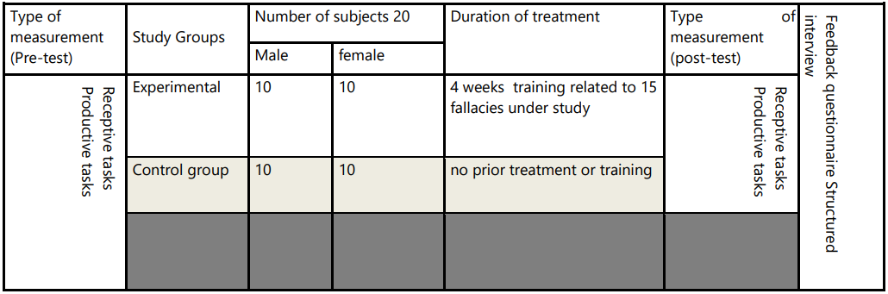
Statistics cont.
(Khartite & Hellalet, 2021, p. 227)
(Khartite & Hellalet, 2021, p. 228)
CS 410
ReasonED.io | Design
Notes:
https://www.researchgate.net/publication/354965770_The_Impact_of_Teaching_Reasoning_Fallacies_on_the_Critical_Thinking_Ability_of_Moroccan_Engineering_Students_The_Case_of_ENSAM_Meknes
Research Overview:
Here, we delve into a study comparing two groups at a Moroccan University - a control group and an experimental group, each consisting of 20 first-year students.
The experimental group underwent four weeks of training on logical fallacies through interactive tasks and whole-class discussions, while the control group solely underwent pre- and post-tests without prior training.
Rigorous control of variables like age, gender, and language proficiency was employed to ensure result reliability.
Measurement Process:
To assess critical thinking proficiency, both groups engaged in a pre-test involving an argumentative task analysis of statements and advertisements.
Subsequently, the experimental group received targeted training on 15 logical fallacies.
The post-test mirrored the pre-test’s task analysis evaluating students on their ability to identify fallacies and produce well-structure arguments.
Statistical analysis, using an independent samples t-test, compared mean scores between the two groups.
Key Findings:
The results are compelling.
The experimental group outperformed the control group in post-test scores.
And, the Statistical analysis (as displayed in the 2nd table) highlighted a significant difference in mean scores between the two groups.
The study concluded that teaching logical fallacies has a positive impact on students’ critical thinking skills.
Implications for ReasonED.io:
So, how does this study connect with ReasonED?
These findings have vital implications for our platform’s instructional strategies and curriculum design.
By integrating logical fallacies into our platform, we not only enhance students’ critical thinking awareness but also align with the study’s call to shift from an overemphasis on general content to a focus on the process of reasoning.
This principle harmonizes with our software’s approach, positioning ReasonED as a valuable resource for nurturing robust critical thinking skills.
With that, Nolan will introduce our problem statement
Research Overview:
In this study, two groups were compared; a control group and an experimental group at a Moroccan University, consisting of 40 first-year students.
The experimental group received training on logical fallacies through interactive tasks and whole-class discussions over four weeks, while the control group only took pre- and post-tests without prior training.
The research carefully controlled variables, such as age, gender, and language proficiency to ensure the reliability of the results.
Measurement Process:
To gauge critical thinking proficiency, both groups participating in a pre-test, engaging in an argumentative task analysis of statements and advertisements.
Subsequently, the experimental group received targeted training on15 logical fallacies.
The post-test mirrored the pre-test’s argumentative task analysis, evaluating students on their ability to identify fallacies and produce well-structured arguments.
Statistical analysis, employing an independent samples t-test, was then used to compare mean scores between the two groups.
Key Findings:
The results are compelling.
The experimental group, which underwent “Reasoning Fallacies training,” outperformed the control group in post-test scores.
Statistical analysis, utilizing an independent samples t-test, demonstrated a significant difference in mean scores between the two groups.
The study concluded that teaching logical fallacies positively affects students’ critical thinking skills.
Implications for ReasonED.io:
So, how does this study relate to ReasonED.io?
These findings hold crucial implications for our instructional strategies and curriculum design.
By seamlessly incorporating logical fallacies into our platform, we not only enrich students’ awareness of critical thinking but also align with the study’s advocacy for a shift from an overemphasis on general content to a focus on the process of reasoning.
This principle aligns with the approach of our software, making ReasonED.io a valuable resource for nurturing robust critical thinking skills.
Original Text (ignore):
Research Focus:
Investigates the impact of teaching reasoning fallacies on critical thinking ability (Khartite & Hellalet, 2021).
Study Participants:
Involves Moroccan engineering students at ENSAM Meknes.
40 first-year university students recruited, randomly assigned to control and experimental groups.
Research Design:
Control group takes pre- and post-tests with no prior training.
Experimental group receives four weeks of training on 15 logical fallacies through interactive tasks and discussions.
Results:
Experimental group outperforms the control group in post-test scores.
Statistical analysis (independent samples t-test) shows a significant difference in mean scores.

Slide 13
Problem
Statement
High school graduates are not prepared with the skills necessary to identify logical fallacies in an increasingly online world.
CS 410
ReasonED.io | Design
Notes:
Heres the problem: High School Graduates are not prepared with the skills necessary
to identify logical fallacies in an increasingly online world.
Lets take a look at some of the characteristics of this issue.
Students don’t learn about logical fallacies until high school, sometimes middle school
When introduced to them, it’s typically only a quick topic in Language Arts/English
Students forget about most of the fallacies after the lesson
Teens/adults are unable to identify flawed logic in others’ reasoning and their own
When on the internet, teens/adults mistake flawed logic for sound logic
Reasoning gets repeated and shared quickly via social media
People rely on said reasoning when discussing issues both online and in-person
| (rewrote bullets below)
v
Late Introduction: Firstly, students don’t encounter logical fallacies until high school, and sometimes not even middle school. This means that they’re introduced to these crucial concepts relatively late in their education.
Brief Coverage: Even when students do encounter logical fallacies, it’s typically only a quick topic in Language Arts or English classes. This limited exposure might not provide them with a comprehensive understanding.
Forgetfulness: It’s a common occurrence that students tend to forget most of what they learn about logical fallacies after the lesson is over, highlighting a need for ongoing reinforcement.
Identification Challenges: As teens and adults, many individuals struggle to identify flawed logic in others’ reasoning as well as in their own arguments. This inability can hinder effective critical thinking.
Internet Misinterpretation: On the internet, especially in the realm of social media, teens and adults often mistake flawed logic for sound reasoning (something that sounds good). This can lead to the spread of misinformation and misconceptions.
Rapid Dissemination: Notably, reasoning that contains logical fallacies gets repeated and shared rapidly via social media platforms, contributing to the perpetuation of flawed arguments.
Impact on Discussions: Ultimately, this reliance on flawed reasoning effects discussions both online and in-person, making it challenging to have informed and productive conversations about various issues.

Slide 14


Problem
Characteristics
Prevalence of Logical Fallacies
Limited Critical Thinking Skills
Misinformation Vulnerabilities
Neglecting Contextual Research
CS 410
ReasonED.io | Design
Notes:
With the prevalence of logical fallacies in online discussions on social media,
graduates utilizing limited critical thinking skills are more vulnerable to misinformation
now more than ever, and may neglect to seek context before making their opinion.
As noted in the previous slides, 50% of high school teachers have said they struggled to find the time to
develop critical thinking skills in their students. This leaves many graduates vulnerable to misinformation,
which may lead to a scenario where someone takes a popular opinion they saw on social media,
instead of performing their own research.
Let me pass this to June to talk about the current process flow.

Slide 15
Current Process Flow
Does existing curriculum provide resources?
Are resources reusable over the course of year?
Are there similar resources to support each grade level?
K-12 educator in need of resources to better teach about logical fallacies
Yes
Yes
No
No
No
Yes
No
Teacher has time/tools to create/find their own resources?
Are they
readily accessible?
Teacher Prepares resource for class
Students forget material/ Don’t develop skills
Yes
No
Yes
Resources won’t get used enough
Students can effectively apply fallacy identification skills
= Initial State
= Final State
CS 410
ReasonED.io | Design
Notes:
Instructors looking to teach logical fallacy detection skills currently face a number of challenges. First they must check existing curriculum to see if it provides resources to teach these skills. If not, they have to spend time ether creating their own materials from scratch or searching through a variety of sources to have the tools they need. Regardless of the source of the materials, there are still a number of challenges to students developing effective fallacy identification skills. If the resources are not reusable over the course of the year, students will not develop adequate skills. If there are not similar resources across grade levels, students will forget material and fail to build on the skills they have acquired. If the materials are not easy to access and use, students will be exposed to the material infrequently will not fully develop fallacy detection skills. Only if all of these elements come together will students be fully supported to build their skills in logical fallacy detection. Now Emily will introduce our solution.
Emily Solution
Let’s break down the current process flow into a more structured narrative to better understand the journey of a K-12 educator in need of logical fallacy teaching resources:
Start State (Step 1): Our journey begins with a K-12 educator recognizing the importance of teaching logical fallacies in their curriculum. They seek resources to enhance their teaching in this domain.
Existing Curriculum (Step 2): The educator’s first checkpoint involves assessing their existing curriculum. Do they already have resources for teaching logical fallacies?
If yes, they proceed to integrate these resources into their teaching in Step 3.
If no, they move to Step 4.
Resource Reusability (Step 3): At this juncture, the educator evaluates the reusability of the resources at hand. Can these resources effectively serve their teaching needs throughout the academic year?
If yes, the resources are versatile and they continue to Step 6.
If no, they face a challenge, prompting them to find their own resources in Step 7.
Resource Creation (Step 4): If the educator has the time and tools to create or find their own resources, they venture into preparing these materials for classroom use in Step 5.
If no, they return to Step 1, restarting the loop.
Resource Preparation (Step 5): Here the teacher invests time and effort in preparing the resources for their class, subsequently lopping back to assess resource reusability in Step 3.
Grade-Level Resources (Step 6): When resources are available, the educator considers whether there are similar resources suitable for different grade levels.
If yes, they adopt them to cater to various grades and proceed to Step 8.
If not, they face challenges in adapting resources for different levels in Step 7.
Student Outcomes (Step 7): If students fail to retain the material or develop the required skills, the educator faces the need to revisiting their teaching resources and methods, initiating the loop to Step 1.
Accessibility and Usability (Step 8): In this step, educators examine whether the resources are easily accessible and user-friendly.
If they are, they proceed to Step 9, where the ultimate goal is achieved.
If not, they encounter difficulties in resource implementation in Step 10.
End State (Step 9): Successful implementation of accessible and user-friendly resources leads to students effectively applying their fallacy identification skills, which is the desired outcome.
Resource Usage (Step 10): In the final step, educators confront the possibility that resources may not get used as intended due to accessibility or usability issues. This situation prompts them to revisit the initial challenge in Step 1.

Slide 16

ReasonED is a game-based learning website that improves the ability of users to identify logical fallacies through simple, age-appropriate games. This website will provide educators with a tool to cultivate their student’s critical reasoning skills over the long-term and beyond the scope of a single subject.
Re sonED
CS 410
ReasonED.io | Design
Notes:
So specifically, what we’re looking at for the real-world product is a website that hosts an elementary school collection of games, a middle school collection of games, high school collection of games, and adult collection of games, respectively. They’ll all share the same goal of introducing and improving logical fallacy identification skills, but the difficulties and approaches will vary depending on the age group. Because our solution is a website, once it’s whitelisted on school networks, students can access it in their free-time during school and really get the chance to have fun with it. Given how schools are pushing to incorporate more technology into lessons, a website like ours has potential to gain a lot of exposure even outside of language arts classes.

Slide 17
Prototype
Overview
3 Games Available on Website:
Hasty Harry
Straw Manny
Slope Sadie
Scaled Difficulty:
Elementary (Grades 2-3)
Middle School (All)
High School (All)
Key Game Features:
Age-Appropriate explanation of fallacy
Educational Feedback
CS 410
ReasonED.io | Design
Notes:
For our prototype, we will be developing and embedding 3, two-dimensional games on our website, each in which a logical fallacy is personified as a fun character with some flawed tendency that corresponds to the fallacy. These will be: Hasty Harry, Straw Manny, and Slope Sadie. While concepts and scenarios will be simplified for younger ages, the games aim to plant the seeds of critical thinking and encourage kids to recognize flawed reasoning. The fallacy characters can serve as memorable guides in their logical fallacy education.
Since we won’t have time to curate difficulties for each individual k-12 grade, we will instead curate them for 3 general age groups: the first group being grades 2 and 3, second being all middle schoolers, and third being all high schoolers. We’ll do this by adjusting the simplicity of the examples, reading levels, feedback, and by adjusting the penalties for wrong answers.
Each game will follow a similar pattern of providing:
an age-appropriate explanation about the specific logical fallacy in focus.
Feedback after each answer to help players understand why the character's thinking is incorrect, so that they can identify similar patterns in real-life scenarios.

Slide 18
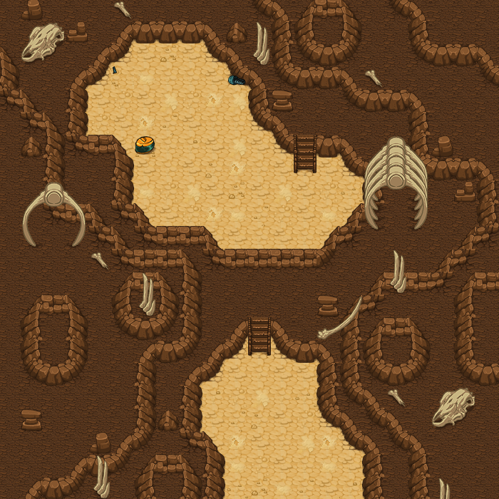
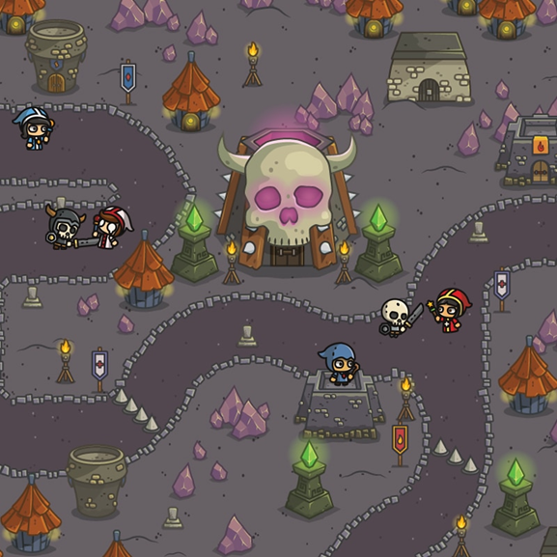
Hasty
Harry
Concept Art/Inspiration:
Harry is an astronaut who makes flawed generalizations about the new creatures and plants he discovers. Players will collect enough information about each planet and help Harry avoid making generalizations in his planet report, teaching the "hasty generalization" fallacy.
CS 410
ReasonED.io | Design
Notes:
Harry is an astronaut who makes flawed generalizations about the new creatures and plants he discovers on planets he visits. Players will collect enough information about each planet and help Harry avoid making generalizations in his planet report, teaching the "hasty generalization" fallacy. This will be a top-view game.
Upon arriving at a planet, players will navigate around to find information about its environment and the creatures that live on it. The Information will be gathered via artifacts that are hidden around the terrain and have a glow around them. For instance, an alien tooth may be an artifact, indicating that there are aliens with teeth on the planet. The artifacts are added to the player’s backpack when found and can be clicked on to review the information they indicate. Players will return to the spaceship when they collect enough artifacts to form a complete picture of the planet.
At the spaceship, Harry begins to create a report about the planet. What Harry types is displayed on the screen. Occasionally, Harry will type a hasty generalization about a specific aspect of the planet. When this happens, players must click a button indicating that the claim is a hasty generalization. They must then click the correct artifact from their backpack to disprove Harry’s claim. For instance, if Harry assumes that none of the aliens have teeth because he saw one without any, the player could select an alien tooth artifact from their backpack to disprove him.
Players will earn points for correctly identifying Harry’s generalizations when he makes them. Players will also earn points when they select the correct artifact to disprove a generalization, extra points being awarded if they choose the correct one on the first try. If players don’t miss any of the generalizations, they will be rewarded with a cosmetic item for their character upon completing the planet report. Completing a report for one planet will unlock the next planet.

Slide 19
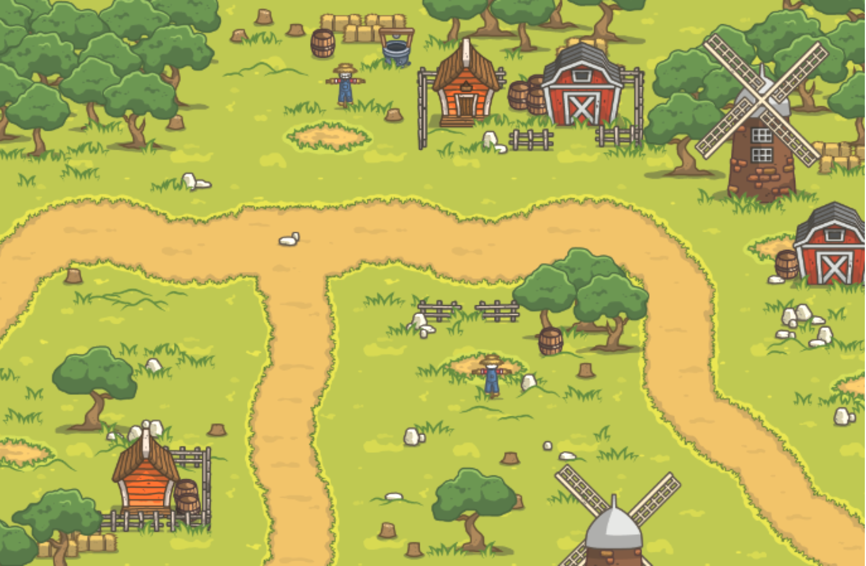
Straw Manny
Concept Art/Inspiration:
Straw Manny is a hopeful knight who needs better training. He only practices combat on fake straw men because they’re easy to hit. Players need to help Manny build his combat skills by attacking real opponents rather than fake ones, teaching the concept of the "straw man" fallacy.
CS 410
ReasonED.io | Design
Notes:
Manny is a hopeful knight who needs better training. He only practices combat on fake straw men because they’re easier to hit. As a result, he isn’t a very skilled fighter. Players need to help Manny build his combat skills by attacking real opponents rather than fake ones, teaching the concept of the "straw man" fallacy.
Players will navigate through a training field with Manny where he can run into real opponents as well as find combat abilities. When players run into an opponent, the opponent will present a claim that Manny needs to respond to. Players will help him pick the correct response from a group of choices. If a valid response is chosen, players can attack the opponent and use any abilities that they have collected. If the player chooses a response to a distorted version of the opponents’ claim (straw man response), Manny misses the opponent and attacks a nearby straw man instead. Every time that happens, he loses a life. If Manny loses a certain amount of lives, the game is over and players will have to restart the level.

Slide 20

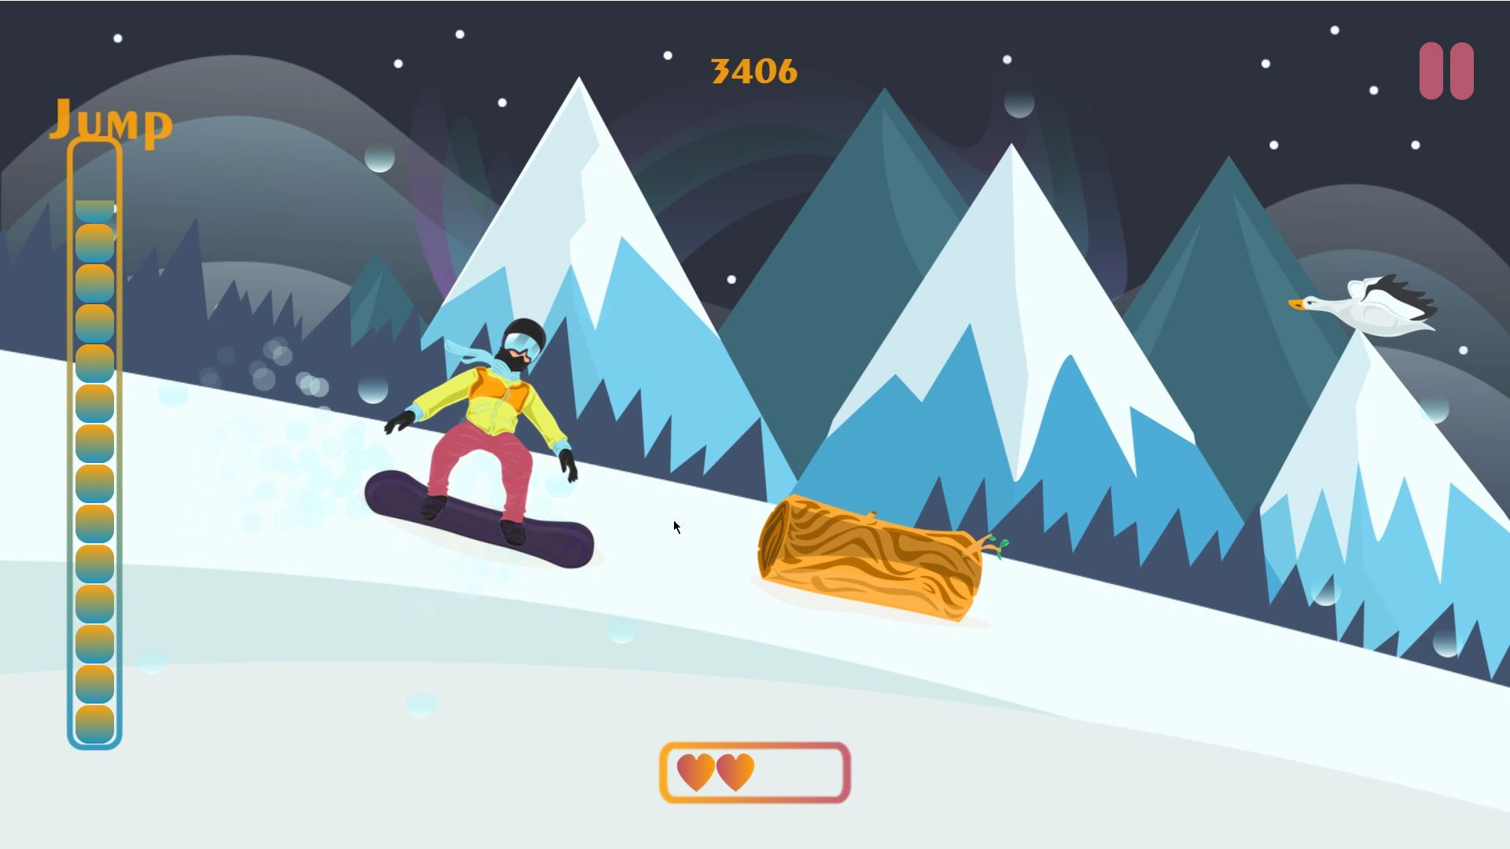
Slope
Sadie
Concept Art/Inspiration:
Sadie often jumps to extreme
conclusions. Players need to guide Sally safely down a winding snowy path without letting her slip into a pitfall, introducing the "slippery slope" fallacy.
CS 410
ReasonED.io | Design
Notes:
Sadie is a character who tends to jump to extreme conclusions. In this game, players need to guide Sadie safely down a snowy path without letting her slip into a pitfall, introducing the "slippery slope" fallacy. This will be similar to a platformer game.
Players control sadie’s vertical movement as she snowboards down a sloped hill. As Sadie descends the snowy slope, she makes exaggerated claims or predictions that represent the slippery slope fallacy. These could be statements like "If I fall once, I'll never be able to snowboard again!" or "If I don't do this trick perfectly, I'll never win any competition!" Players are presented with response options that counter Sadie's fallacious claims with more reasonable or logical statements. For instance, they might be given responses like "Falling once won't stop you from snowboarding!" along with other choices that support her fallacy instead. Players need to select the most appropriate response to Sadie's claim before she reaches a critical point on the slope. Choosing the correct response helps Sadie maintain balance and continue down the slope safely, while choosing incorrectly causes her to slip.
Now I’ll pass it off to Areeb to discuss our customers and end users.

Slide 21
Features
ReasonED WILL contain:
Simple, school-friendly 2D games to be played directly on the site
Wide range of game difficulties
Instructions for each game
Introductory readings for each age group
ReasonED will NOT contain:
RAM and CPU-intensive elements
Lesson plans (unless provided by educators)
In-game references to specific people or political events
CS 410
ReasonED.io | Design
Notes:
To make the scope of our solution more clear, I’ll break down some of the features that it will have and won’t have.
-ReasonED will contain 2D games that will be playable directly on the website, so logging in or downloading will not be necessary to play them. Players will only need to sign up to be eligible for leaderboards, but signing up will be completely free.
-We WILL have a wide range of game difficulties for elementary, middle, high school students, and adults respectively. Having a big collection of games available across such a large segment of the educational spectrum is very crucial to our problem because, as you saw from the current process flow, most existing resources fall short of supporting year-long learning, much less supporting continuous learning over all of the grade levels.
-We WILL include In-game tutorials for each of our games, and all of the text in the games will have text-to-speech options for better accessibility, especially for younger players who can’t read well yet.
-Lastly, our website will have readings to help introduce the concept of logical fallacies to each individual age group. The idea behind this is to provide some brief background knowledge to users in case they aren't accessing the site for a school lesson, because one goal of the site is being playable outside of the classroom. These readings will have text-to-speech options as well.
Some features ReasonED WILL NOT have are:
-Game and website elements that are too intensive. Browsers alone can use a lot of RAM, and not every school or household can afford high-end devices. So we want the site to be relatively fast, not be cluttered, and we want to keep the games lightweight enough to be playable even on lower-end devices.
- We won’t be developing lesson plans. We’d love to be able to include them for teachers since those are great educational tools, but our main priority will be the games. With that said though, we could absolutely host resources like that if they're provided to us.
-Lastly, ReasonED won’t contain references to specific people or political events. This can become a fine line to walk when we're developing the gameplay for older players, since we'll want examples in the games to more applicable to the real world, and in the real world logical fallacies are seen very often in politics. Ultimately though, we want to avoid referencing political arguments. We don't want the site to contain any political bias, especially since a goal of ours is for it to be used in schools.

Slide 22

Customers & End Users
Customers:
K-12 schools
Colleges
Universities
Educational publishers
End Users:
K-12 Students (including homeschoolers)
College Students
Educators
General Public
CS 410
ReasonED.io | Design
Notes:
Our primary customers are educational institutions, including K-12 schools, colleges, and universities. These institutions are at the forefront of education, and ReasonED can serve as a valuable resource in their curriculum and foster critical thinking skills among students.
Additionally, we extend our reach to educational publishers and content providers. They can explore adopting ReasonED as a tool to complement their existing offerings, providing an enriched learning experience for their audience.
Now let’s talk about the end users who will directly benefit from this platform.
First, we have K-12 Students (including homeschoolers). These young minds are our core audience. ReasonED aims to empower them with improved critical thinking skills through engaging games and educational content.
Next we have, College Students. We are extending our reach to include college-level students as the transition to higher education presents new challenges and ReasonED can continue to support critical thinking development at this level.
Then we have Educators. Instructors (both k-12 teachers and professors) play a pivotal role in guiding students’ learning journeys. ReasonED can be a valuable tool for educators to incorporate into their teaching methods.
And lastly we have the General Public: Beyond the classroom, critical thinking is a skill that holds value in various aspects of life. The general public can access ReasonED to enhance their ability to identify logical fallacies, ultimately contributing to more informed discussions both online and offline.
Now, June will go over the Solution Process Flow..

Slide 23
Solution Process Flow
Does existing curriculum provide resources?
Are resources reusable over the course of year?
Are there similar resources to support each grade level?
K-12 educator in need of resources to better teach about logical fallacies
Yes
Yes
No
No
No
Yes
Are they
readily accessible?
Teacher Finds ReasonED
No
Yes
Students complete readings to learn about types of fallacies
Students play games to practice identifying each fallacy
Students can effectively apply fallacy identification skills
= Initial State
= Final State
CS 410
ReasonED.io | Design
Notes:
ReasonED will provide resources instructors are missing to support effective logical fallacy detection instruction. If the existing curriculum does not provide resources, ReasonED will provide instructional resources. If existing resources are not reusable, ReasonED will be a reusable resource for logical fallacy detection. If existing resources do not support multiple grade levels, ReasonED will provide increasing challenges as students grow. And if existing resources are not easy to access or use, ReasonED will be available as an easy to set up and use option. By being an all-in-one solution to these problems, instructors will not have to spend time creating and searching for materials to teach logical fallacy skills and will be better able to support students as they master these skills.
Dakota Competition
ReasonedIO solves many of the problems in the current process. It eliminates most of the extra work and pitfalls educators face when attempting to provide logical fallacy instruction. It provides prebuilt resources to reinforce logical fallacy detection that are easily accessible and reusable both over the year and at different grade levels. By having consistent practice throughout their education, students will develop effective skills in detecting logical fallacies.

Slide 24
Competition Matrix
Direct Competitors
 | ReasonED.io | ABCya! | Funbrain | Arcademics | BrainPOP
Primary Audience | K-12 and College | Pre-K - 6 | Pre-K - 8 | K-8 | K-8
Game-Based Learning | ✓ | ✓ | ✓ | ✓ | ✓
Logical Fallacy Focus | ✓
Device Compatibility | PC | PC | PC | PC | PC
Characters and Animation for Kids | ✓ | ✓ | ✓ |  | ✓
Accessibility Features | ✓
Educator Tools | ✓ | Premium Only |  | Premium Only | ✓
Easily Playable outside of School? | ✓ | ✓ | ✓ | ✓ | ✓
Cost | Freemium | Freemium |  | Freemium
CS 410
ReasonED.io | Design
Notes:
Most of our direct competitors share a similar set of features and requirements that we have for ReasonED. We want to cover a broad audience from kindergarten up to college. To do so we want to focus on game based learning to keep users engaged, utilize characters and animation to help keep younger kids focused, and playable outside of school. What separates us from our competitors is our focus on logical fallacies and accessibility features such as text to speech for visually impaired users, keyboard navigation options, and adjustable font sizes. Given that our site focuses solely on logical fallacies, if one of our competitors such as Funbrain decided to incorporate logical fallacies into their site, they would likely be lost in their sea of other games and were back at square one where logical fallacies are getting no attention. Next Slide
Who are our competitors?
Kahoot! - An interactive learning platform that allows educators to create and hosts quizzes, surveys, and interactive games in a classroom or remote learning environment.
Engages students though competitive and engaging quiz-based activities
Users can participate using a mobile device or computer
Quizlet Live - A new feature of the popular learning platform that allows educators to host flashcard games live, similar to Kahoot
Users can create their own study materials or access a vast library of user-generated content
Offers a range of study modes and interactive games
Socrative - An assessment and engagement platform for teachers and students.
Educators can create quizzes, surveys, and quick assessments to gauge student understanding and engagement
Allows real-time feedback and reporting, making it useful for both in-class and remote learning environments
GimKit - An educational game-based platform designed to make learning fun and engaging.
Offers interactive quizzes and games where students earn virtual currency to upgrade their avatars and compete with classmates
Teachers can create and customize content
Factors to discuss
Primary audience - Specifies the main target audience or user base of the platform.
Game-Based Learning - Indicates whether the platform is known for game-based learning experiences, where users can engage with educational content through interactive games.
Logical Fallacy Focus - Specifies if the platform has a specific focus on teaching and identifying logical fallacies in arguments. Our website focusing solely on logical fallacies is beneficial for spreading awareness about the problem at hand. If logical fallacy games were to just be added to existing, all-subject game sites, they would likely get lost in the sea of other games, and we're back at square one. Having their own site serves to give logical fallacy concepts the undivided attention they've been lacking.
Device Compatibility - Specifies what device can be used to access the platform.
Characters and Animations - specifies whether the competitor’s games emphasize engaging features specifically for younger kids
Educator Tools - Indicates whether the platform provides tools and features provided for educators, like class management, progress tracking, or assignment creation.
Accessibility - Refers to how easily and effectively users with different needs, including those with disabilities, can interact with and use the platform. This can include features such as text-to-speech for visually impaired users, keyboard navigation options, adjustable font sizes, and compatibility with screen users.
Playability outside of school- Indicates whether or not the games are just as accessible for users if not used at school, for instance, without a game code. Many of our competitor’s sites don’t have accessible games aside from their live game mode for in-school use.
Cost - Specifies the pricing model of the platform, whether it’s subscription-based, freemium (offering free and premium versions, or other pricing structures.
When discussing accessibility
Kahoot!
Keyboard Navigation (without a mouse)
Screen Reader Support (for users with visual impairments)
Color Contrast (for users with visual impairments)
Text-To-Speech (for users with visual impairments and reading difficulties)
Closed Captioning (for users with hearing impairments)
Quizlet
Keyboard Navigation
Screen Reader Support
Color Contrast
Keyboard Shortcuts
Text-To-Speech
Closed Captioning
Socrative
Keyboard Navigation
Screen Reader Support
Adjustable Font Sizes (for users with visual impairments)
Color Contrast
Closed Captioning
Responsive Design (features work on various devices)
GimKit
Keyboard Navigation
Color Customization
Responsive Design
Text-To-Speech (for users with visual impairments and reading difficulties)

Slide 25
Competition Matrix
Indirect Competitors
 | ReasonED.io | Kahoot! | Quizlet Live | Socrative | Gimkit
Primary Audience | K-12 and College | K-12 and College | K-12 and College | K-12 | K-12
Game-Based Learning | ✓ | ✓ | ✓ |  | ✓
Logical Fallacy Focus | ✓
Device Compatibility | PC | PC, Phone | PC, Phone | PC, Phone | PC, Phone
Characters and Animation for Kids | ✓ | Depends on Game |  |  | Depends on Game
Accessibility Features | ✓ | ✓ | ✓ | ✓ | ✓
Educator Tools | ✓ | ✓ | ✓ | ✓ | ✓
Easily Playable outside of School? | ✓
Cost | Freemium | Freemium | Freemium | Freemium | Subscription
CS 410
ReasonED.io | Design
Notes:
Our indirect competitors are similar in accessibility features, educator tools, and game based learning, but they differ heavily when it comes delivery of the games and easability of being played outside of school. For example, Quizlet Live and Gimkit are based around live session based games with Gimkit being similar to jeopardy and both require a teacher to create the game for the students. With that said I will leave it to Alysha to cover our technical risks
Who are our competitors?
Kahoot! - An interactive learning platform that allows educators to create and hosts quizzes, surveys, and interactive games in a classroom or remote learning environment.
Engages students though competitive and engaging quiz-based activities
Users can participate using a mobile device or computer
Quizlet Live - A new feature of the popular learning platform that allows educators to host flashcard games live, similar to Kahoot
Users can create their own study materials or access a vast library of user-generated content
Offers a range of study modes and interactive games
Socrative - An assessment and engagement platform for teachers and students.
Educators can create quizzes, surveys, and quick assessments to gauge student understanding and engagement
Allows real-time feedback and reporting, making it useful for both in-class and remote learning environments
GimKit - An educational game-based platform designed to make learning fun and engaging.
Offers interactive quizzes and games where students earn virtual currency to upgrade their avatars and compete with classmates
Teachers can create and customize content
Factors to discuss
Primary audience - Specifies the main target audience or user base of the platform.
Game-Based Learning - Indicates whether the platform is known for game-based learning experiences, where users can engage with educational content through interactive games.
Logical Fallacy Focus - Specifies if the platform has a specific focus on teaching and identifying logical fallacies in arguments.
Device Compatibility - Specifies what device can be used to access the platform.
Characters and Animations - specifies whether the competitor’s games emphasize engaging features specifically for younger kids
Educator Tools - Indicates whether the platform provides tools and features provided for educators, like class management, progress tracking, or assignment creation.
Accessibility - Refers to how easily and effectively users with different needs, including those with disabilities, can interact with and use the platform. This can include features such as text-to-speech for visually impaired users, keyboard navigation options, adjustable font sizes, and compatibility with screen users.
Playability outside of school- Indicates whether or not the games are just as accessible for users if not used at school, for instance, without a game code. Many of our competitor’s sites don’t have accessible games aside from their live game mode for in-school use.
Cost - Specifies the pricing model of the platform, whether it’s subscription-based, freemium (offering free and premium versions, or other pricing structures.
When discussing accessibility
Kahoot!
Keyboard Navigation (without a mouse)
Screen Reader Support (for users with visual impairments)
Color Contrast (for users with visual impairments)
Text-To-Speech (for users with visual impairments and reading difficulties)
Closed Captioning (for users with hearing impairments)
Quizlet
Keyboard Navigation
Screen Reader Support
Color Contrast
Keyboard Shortcuts
Text-To-Speech
Closed Captioning
Socrative
Keyboard Navigation
Screen Reader Support
Adjustable Font Sizes (for users with visual impairments)
Color Contrast
Closed Captioning
Responsive Design (features work on various devices)
GimKit
Keyboard Navigation
Color Customization
Responsive Design
Text-To-Speech (for users with visual impairments and reading difficulties)

Slide 26
Technical Risks
Impact
T1: Version Compatibility
Risk: Compatibility issues with varying browsers.
M1: Keep up with browser updates, maintain backward compatibility.
T2: Third-Party Integrations
Risk: Problems with integrating external services or APIs.
M2: Careful selection and testing of third-party tools or APIs.
T3: Data Backup and Recovery
Risk: Risks of data loss or system failure.
M3: Implement regular data backup and recovery procedures.
Impact
 | Very Low | Low | Medium | High | Very High
Very High
High
Medium |  |  | T1 | M3 | T3
Low |  | M1 | M2 | T2
Very Low
Likelihood
CS 410
ReasonED.io | Design
Notes:
Here, we will dissect the challenges faced both pre-mitigation and the strategic steps taken post-mitigation to fortify our educational platform.
Version Compatibility
Pre-Mitigation:
First on the list, we recognized that version compatibility issues held a medium impact on our software.
The risk stemmed from the diversity in browser versions, potentially disrupting the user experience.
For the experience, imagine users facing slow loading times or features not working as intended due to outdated compatibility.
The likelihood was also medium, given the routine nature of browser updates, each carrying the potential to affect our application’s performance.
Without careful maintenance and updates, the risk of these issues arising is significant.
Post-Mitigation:
For Post-Mitigation, we’ve implemented a robust version control and testing process.
Regular compatibility checks with different browser versions are now standard procedure.
Proactively identifying and addressing compatibility concerns has reduced the impact on the user experience.
We’ve also established a responsive support system to swiftly address user concerns.
Our goal is simple: minimal disruption and user dissatisfaction, especially when those inevitable browser updates are released.
Third-Party Integrations
Pre-Mitigation:
Moving on to another critical area - the risk associated with third-party integrations.
Our assessment revealed a high pre-mitigation impact.
Issues with external services or APIs could significantly disrupt our application’s functionality.
The likelihood, though low, hinged on the selection and testing of third-party tools or APIs.
Hasty or poorly-tested integrations could increase the likelihood of problems, posing a potential threat.
Post-Mitigation
So, our post-mitigation strategy is to perform thorough research and testing before integrating any external services.
This involves a comprehensive testing process for third-party tools to ensure reliability and suitability for our software.
By doing so, we’ve effectively reduced the impact of integration issues on our application’s functionality.
Regular audits and monitoring of our integrated services are now in place, ensuring a high level of reliability remains our top priority.
Data Backup and Recovery
Pre-Mitigation
Lastly, let’s explore the risk of data loss and system failure.
Pre-mitigation, we recognized this risk as the highest impact.
System failure can lead to extended downtime, disrupting user access and causing a loss of trust.
The likelihood, although medium, underscored the importance of regular backup and recovery procedures.
Without these measures, the risk of data loss ir system failure remained moderately likely.
Post-Mitigation.
To tackle this, we’ve implemented a robust backup and recovery system.
Regular and automated backups ensure that critical user data, such as personal addresses and passwords, is protected and can be swiftly restored in the event of a data loss or system failure.
This reduces the impact on users and mitigates potential trust loss.
System health monitoring and maintenance, including regular checks and data integrity assessment, further help identify and address issues before they escalate.
I’ll hand it over to Nolan to discuss the customer and security risks.

Slide 27
Customer Risks
Impact
C1: User Proficiency
Risk: Users may not have the prerequisite knowledge or skills to benefit from the application.
M1: Tutorials and introductory lessons help lower the bar for new users.
C2: User Engagement
Risk: Customers may not feel the need to stay engaged with the games.
M2: Progress tracking and regular content updates help to maintain user interest.
C3: User Feedback
Risk: If a game is too difficult or is not explained well, then users might stop using the application.
M3: Provide feedback mechanisms to iterate on the game.
 | Very Low | Low | Medium | High | Very High
Very High
High |  |  |  | C2
Medium |  |  |  | C1
Low |  |  | C3 | M2
Very Low |  |  | M3 | M1
Likelihood
CS 410
ReasonED.io | Design
Notes:
Three risks that pertain to customers include user proficiency, user engagement, and user feedback.
We recognized that users who aren't proficient enough with computers may avoid using our product.
User proficiency was categorized as a high impact risk with users completely disengaging with the product.
To alleviate this, we decided to introduce optional tutorials to help lower the bar of entry to new users.
This mitigation lowers the likelihood of users leaving due to possible user limitations.
We noticed that user engagement tends to decrease over time. We assessed that the impact is the same as
user proficiency, with a higher likelihood since more users are likely to encounter this issue. To help reduce the lack of engagement, we
decided to introduce progress tracking on our games. Along with regularly scheduled content updates, our product
encourages users to return and continue their progress on current and new games.
With that said, we need to be able to examine user response to our product,
in the event one of our features isn't working quite as intended. Users may get caught up on a game or other
resource and choose to stop using our product if it becomes too difficult. Placing this risk at a medium impact
and likelihood, we decided to introduce feedback mechanisms to allow users to give feedback after attempting a game.
This helps to lower the chances of users leaving after a difficult game, and gives us a chance to fix any issues in production.
Let's continue on to the security risks.

Slide 28
Security Risks
Impact
S1: Data Security
Risk: Users may be concerned about what data is collected on them.
M1: Communicate what data is gathered, and comply with data protection regulations to keep collected data safe.
S2: Account Security
Risk: Unauthorized access to a user account.
M2: Strong password policies and two-factor authorization for account login.
S3: Security Updates
Risk: New exploits are discovered which jeopardize our systems.
M3: A regular schedule for checking for exploits and implementing security patches.
 | Very Low | Low | Medium | High | Very High
Very High
High |  |  |  | S2
Medium |  |  | S1 |  | S3
Low
Very Low |  | M1 | M2 | M3
Likelihood
CS 410
ReasonED.io | Design
Notes:
On the topic of collecting feedback, users may feel concerned about the data we collect for our games.
Placing this at a medium likelihood and impact, we decided to display to users what data we collect,
and how it helps us develop or improve our product. This significantly lowers the likelihood and impact of the risk.
We also intend to follow any data collection regulations necessary to keep user data safe. // if questioned about a data protection regulation, mention the california consumer privacy act
Account security is a major concern of ours, placing it at high likelihood and a high impact of user accounts being breached.
With such a high likelihood, we decided that having strong password policies and a two-factor authorization was a must.
With our solution, we find that strong password policies significantly mitigate the likelihood of the risk,
with two factor authorization mitigating the risk of account breaches, the risk is significantly reduced.
And finally, as new exploits are discovered, we need to be prepared to handle this very high impact issue.
Our mitigation for this is to develop a regular schedule for our team to take time and research
exploits that could affect our systems. Following a good schedule for fixing vulnerabilities, this
significantly lowers the likelihood and risk of these exploits.
I will now pass the presentation off to Emily

Slide 29
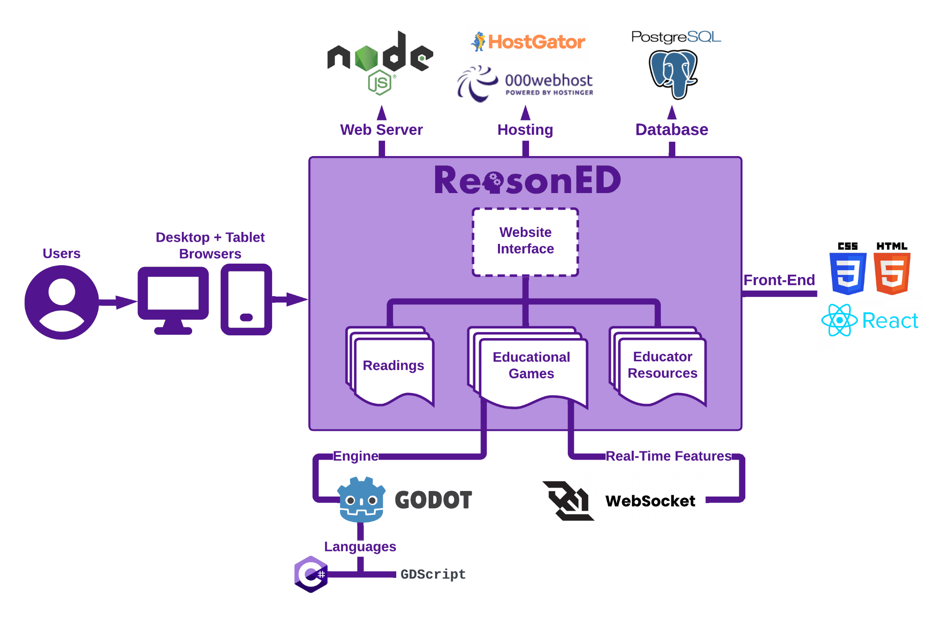
MFCD
CS 410
ReasonED.io | Design
Notes:
Users will interact with Reason.io through Desktop and Tablet browsers. The website's frontend will be developed using HTML5, CSS 3, and React for dynamic elements. The primary component of our site is the collection of games. These will be developed using Godot, with C# and GDScript as our languages. Any real-time features such as leaderboards will be implemented with Websocket. Websocket will be connected to a Node.js web server, and any leaderboard data or data for signed-up users will be stored in a PostgreSQL database. We haven’t finalized a hosting service yet, but both HostGator and webhost are services we would consider for the scope of the real world product. Now Nolan will discuss the work breakdown structure.

Slide 30
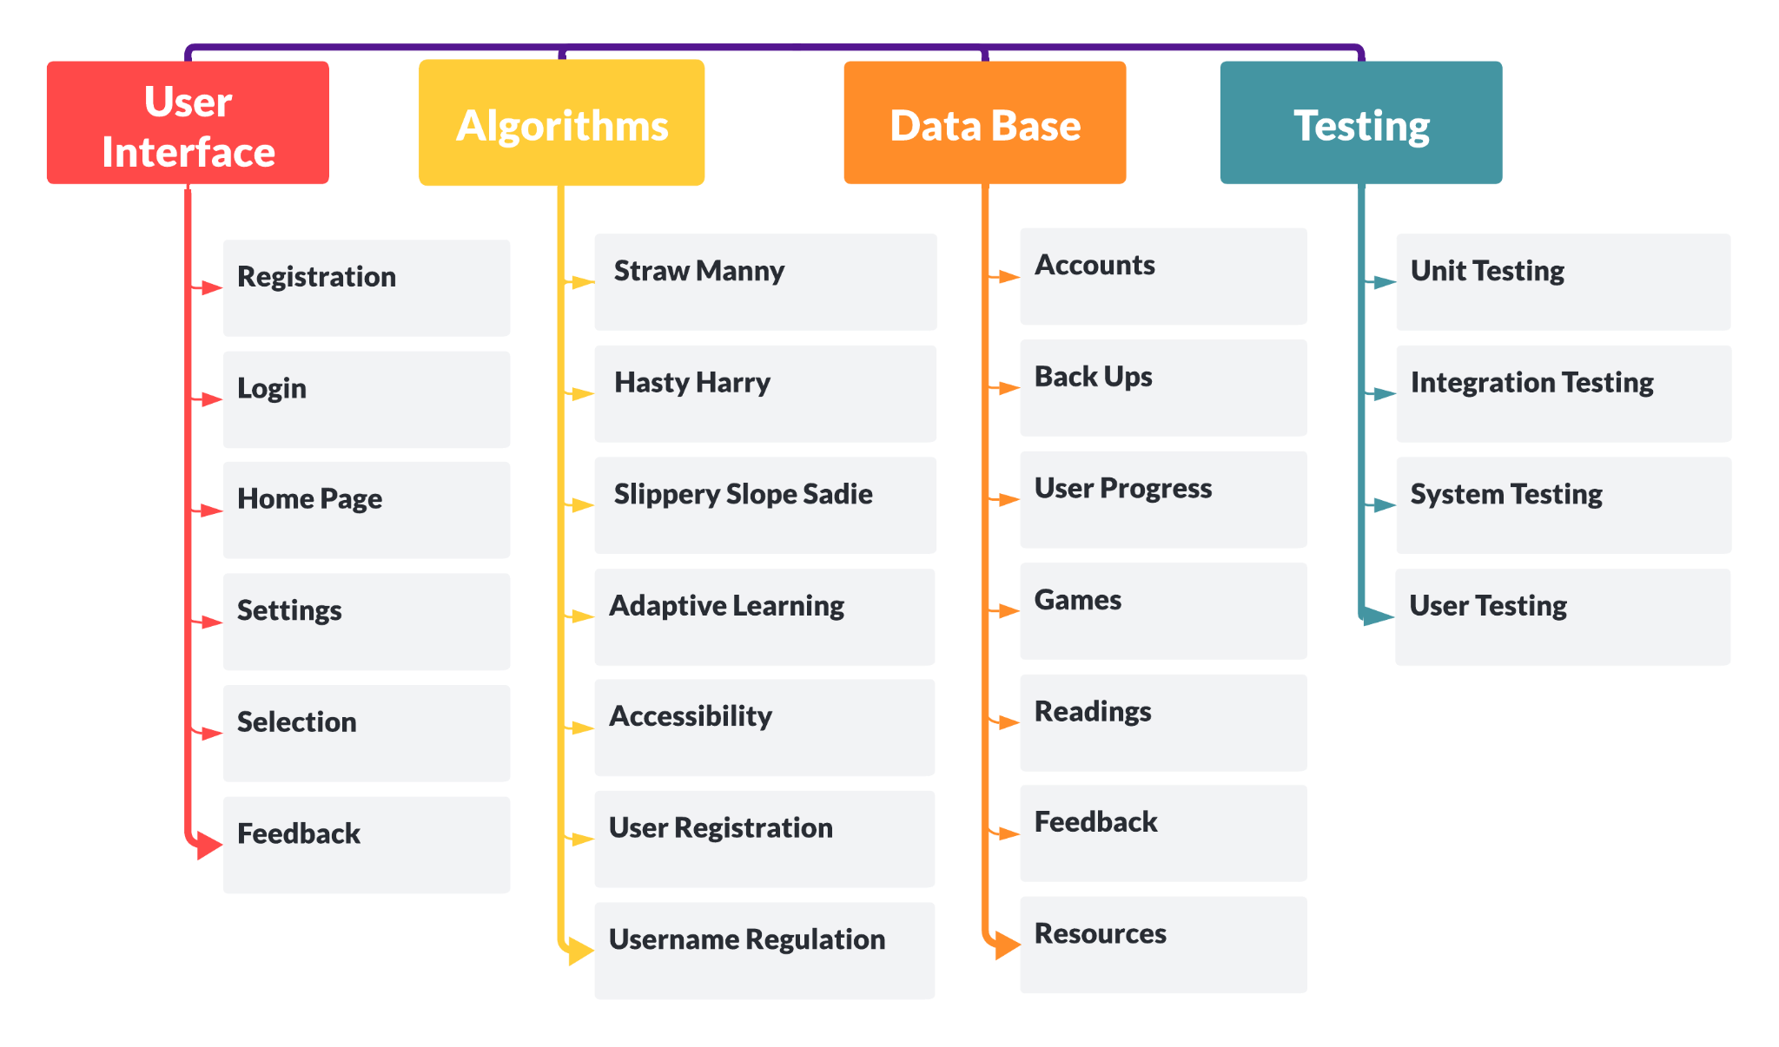
Work Breakdown
Structure
CS 410
ReasonED.io | Design
Notes:
Here is our current work breakdown structure. I would like to note that at this time the colors are mostly eye candy,
and I will note the significance as I go over it.
On the left, we have the user interface.
The user interface includes the menus for our registration and login pages, as well as other menus like the games and setting menus.
The color blue is used to signify that this is a part the user interacts with.
The algorithms category includes features like our planned games and other use features like accessibility.
Emily will cover these more in an upcoming slide. I colored the algorithm category yellow here, like the box indicating
our product, Reasoned.io. This is because the algorithms make up the meat and bones of our project, and it is what users
interact with the most.
With the database category, we list what we need to store, like data for user accounts, backups,
and user progress data for example. This is colored blue like the user interface, as this is something the user interacts with.
Users utilize the user interface, users update their data as they use our product.
Alysha will cover this category in more detail shortly.
The last category is testing, this is colored red to signify that this is separate from the rest of our product,
with testing being exclusively for developers, and have no involvement with the user.
Lets transition to the user interface structure.

Slide 31
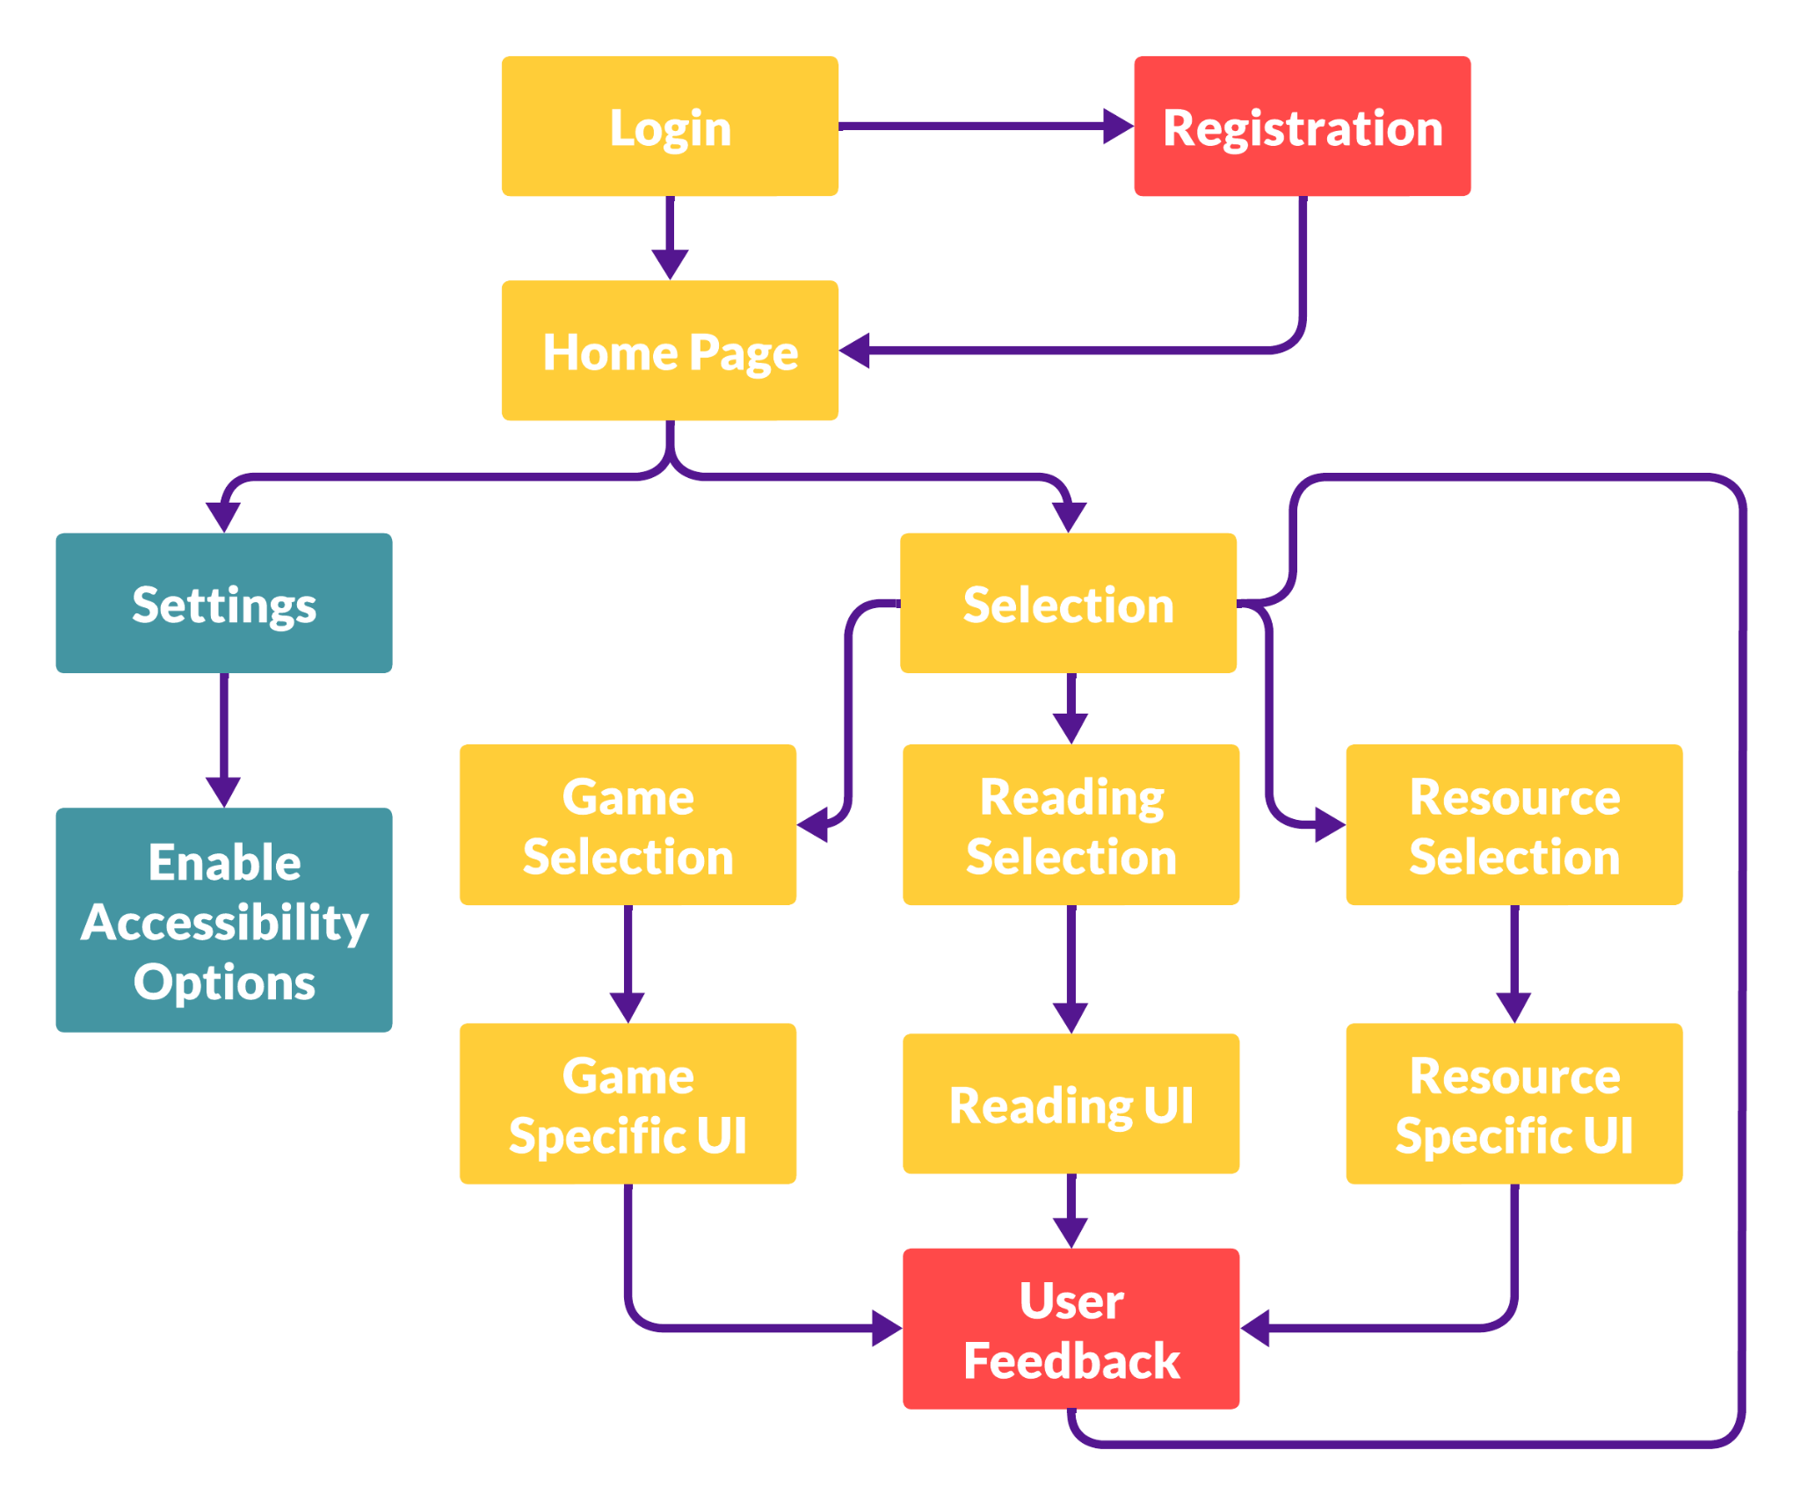
Work Breakdown - UI
CS 410
ReasonED.io | Design
Notes:
Here we can see the structure for our user interface.
The color yellow signifies the main process that users need to follow to use our product.
Currently, the user starts the process
with logging in. If they're not logged in, they will transition to the registration page.
Red is used here to signify a process that isn't considered to be a part of a main usage loop.
Once the user is registered and logged in, it brings the user to the home page.
From the home page, the user can choose to select an activity, or modify their settings,
such as enabling any accessibility options. Blue is used here to signify that this is intended to alleviate user issues,
and isn't considered to be a part of the main process.
Once the user has made their selection of either a reading, a game, or some other resource,
they start their activity and interact with the activity UI, which may change depending on the activity.
After the user is finished, they are prompted to see if they would like to leave feedback on the activity.
I denoted this as red, as we don't expect feedback every time an activity is finished.
As such, the user can choose to either leave or skip feedback, and they are brought back to the selection screen.
From here, they can choose to play another activity, or they can close the webpage if they are done.
Now Emily will begin explaining our algorithms.

Slide 32
Algorithms
Games
Character Customization
Feedback & Event systems
Item Unlocks/Certificates
Adaptive Learning
User Registration and Authentication
Username Regulation
CS 410
ReasonED.io | Design
Notes:
Here are some major algorithms that we'll be building for our prototype, many of which fall under game development.
Our three prototype games will all contain algorithms for:
-Character selection and customization
-Educational Feedback and event systems triggered by right and wrong answers, and
-Item unlocks or completion certificates
Aside from gameplay algorithms, we'll also have:
an Adaptive Learning Logic, which will
adjust the difficulty of challenges based on a user's performance
a User Registration and Authentication algorithm, and finally
- a Username Regulator that will check desired usernames against a blacklist of phrases and symbols that are now allowed. Now I'll it hand over to Alysha for the Databases...

Slide 33
Hasty
Harry
Next planet is unlocked
Player navigates around the planet to find artifacts
Player runs into an artifact and reads about it
No
All artifacts collected?
Score and Unlocks Reveal
Player returns to spaceship, Harry begins his report
Yes
Player
Clicks Button?
Hasty
General-
ization?
Harry types a sentence for the report to the screen
Yes
Yes
No
No
Player
Clicks Button?
Feedback and Points Awarded
Feedback and Points Deducted
Yes
Feedback and Points Deducted
Repeat 5x
CS 410
ReasonED.io | Design

Slide 34
Straw
Manny
Enemy presents claim, response options appear
Player picks straw man response?
Manny attacks straw man
Yes
Player finds combat abilities
Player runs into enemy
No
Feedback and Points Deducted
Feedback
Next training ground is unlocked
Player runs through training grounds
Points computed and awarded
Player can choose abilities to attack enemy with*
Score and Unlocks Reveal
Repeat Until 5 Enemies Defeated or All Lives Lost
CS 410
ReasonED.io | Design

Slide 35
Slope
Sadie
CS 410
ReasonED.io | Design

Slide 36
Adaptive
Learning
CS 410
ReasonED.io | Design

Slide 37
Username
Regulation
Username is sanitised to prevent malicious input
Ensure the length of username is within the specified limits
If length is below min or exceeds max, mark as invalid
Check if it contains only allowed characters per defined pattern
Gets filtered for inappropriate content
Provide user feedback on the reason for invalidity if applicable
If passes all validation checks, username is valid
Integrate the username into the user registration process
CS 410
ReasonED.io | Design
Notes:
Now I'll it hand over to Alysha for the Databases...

Slide 38
User
Registration
User enters email, username, password into fields
Email is checked client side to ensure it follows a valid format
Username is checked client side to follow our regulations
Once everything confirms valid on the client, Submit button is valid
User submits their entries
Password is hashed before sending
User email is confirmed valid server side
Username is confirmed to follow our regulations
Remainder of inputs are sanitised
If any inputs had to be altered by the server, reject the submission
CS 410
ReasonED.io | Design

Slide 39
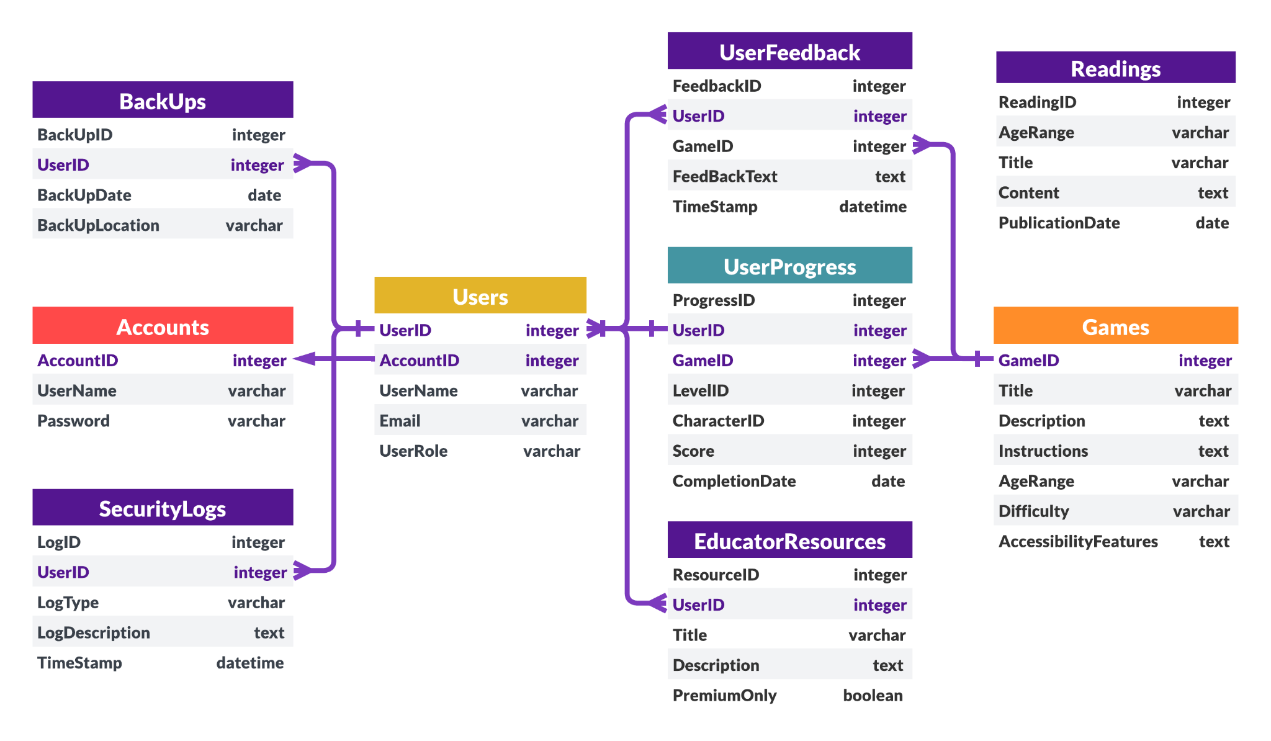
Database Schema
CS 410
ReasonED.io | Design
Notes:
Link to current draft:
https://lucid.app/lucidchart/5e3fe383-1651-4c02-8f82-7876e6fbf15e/edit?viewport_loc=740%2C54%2C1483%2C876%2C0_0&invitationId=inv_57f73602-21b0-4e9f-b83b-5895164ffd26
Our main database schema serves as the blueprint orchestrating the flow of information. Let’s explore each table in detail, starting with the core components.
Accounts Table:
The Account table is the keeper of user account information.
It establishes a One-to-One relationship with the Users table, ensuring a direct link between each user and their account details.
Users Table:
Users, the central hub, manages BackUps, SecurityLogs, UserFeedBack, and EducatorResources.
Each entry in these tables are tied to a specific user.
Access to these tables is determined by the UserRole, distinguishing between students and educators.
BackUps Table:
The backbone of our system, the BackUps table, manages individual user data.
This consists of everything from account details to detailed progress data in various games, including levels and achievements.
SecurityLogs Table:
The SecurityLogs table records security-related events, descriptions, and timestamps.
This includes login attempts, changes in user privileges, and other incidents.
This connection enables us to trace security events back to individual users, ensuring a comprehensive security record.
UserFeedBack Table:
Each feedback entry is linked to a specific user and a particular game.
This structure allows us to capture valuable insights into user thoughts and experiences with various games.
EducatorResources Table:
The EducatorResources table is associated with specific users who serves as educators.
It stores essential information about each resource, including titles and descriptions of lesson plans, teaching strategies, and educational tools.
Additionally, It tracks whether a resource is premium, providing clarity on its accessibility.
Games Table:
Our Games table acts as a database for our range of games.
UserProgress Table:
The UserProgress table acts as a bridge by recording each user’s progress, scores, and completion dates across the different games.
Readings Table:
Finally, our self-contained library, Readings, offers a rich collection of reading materials on logical fallacies accessible to everyone who goes to the platform.

Slide 40
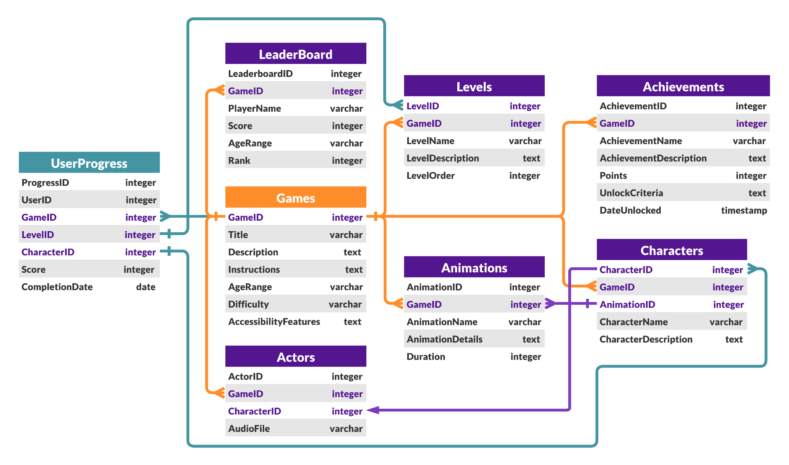
Database Schema
CS 410
ReasonED.io | Design
Notes:
Link to current draft:
https://lucid.app/lucidchart/88ca6b5d-6254-4d50-8dff-d59aa54fec68/edit?view_items=jZATy.eJK-8L&invitationId=inv_b1d9b8ab-131c-4ac1-ae69-58ea5e71e8b2
For this slide, we have our game schema that goes into more detail about the aspects of the games on our platform. The tables that we will be discussing are all in a dark purple color.
Actors Table:
The Actors table is where we store character dialogues, voice acting, sound effects, or any other auditory cues linked to specific characters.
This table has a Many-to-One relationship with the Games table, meaning that many actors can belong to one game.
It also has a One-to-One relationship with Characters, as each actor will correspond to a unique character.
This setup allows us to associate multiple actors with a specific game.
Levels Table:
The Levels table manages the different levels present in our games.
Similar to the Actors table, it has a Many-to-One relationship with the Games table.
This enables us to associate multiple levels with a specific game.
Achievements Table:
Achievements, a key aspect of gaming, are stored in the Achievements table.
This table has a Many-to-One relationship with the Games table, allowing us to associate multiple achievements with a specific game.
Each achievement represents a milestone or accomplishment within a game.
It includes details such as the name, description, point value, unlock criteria, and type.
Achievements contribute to the overall gaming experience by rewarding players for their accomplishments.
Characters Table:
Each character and their information including Manny, Harry, and Sadie are stored in the Characters table.
Like Actors and Levels, this table has a Many-to-One relationship with the Games table, allowing multiple characters to be associated with a specific game.
Animations:
Animations table stores data related to character and environment animations
The table also has a Many-to-One relationship with the Game table, facilitating the association of multiple animations with a specific game.
Additionally, it has a One-to-Many relationship with the Characters table, allowing multiple animations to be associated with a specific character..
Details may include the name, description, duration, and other relevant attributes.
Leaderboard Table:
The Leaderboard table tracks user scores and rankings for every user.
It has a Many-to-One relationship with both the Games and Users tables.
This structure enables us to associate many leaderboard entries with one game and one user, allowing for a comprehensive tracking of user performance across different games.
Leaderboards provide a competitive element to the gaming experience, allowing users to see how they rank against others.
Now Emily will discuss the Real world product vs. Prototype

Slide 41
RWP vs. Prototype
Features & Functionality | RWP Features | Planned Prototype | Actual Prototype
PC & Tablet compatibility | ✓ | ✓
Characters+ Animations | ✓ | ✓
Accessibility Features | ✓ | Text-to-Speech
Educator Tools | ✓ | Printable Graphics, Progress Tracking
Paid Features | ✓
Games for k-12+ | ✓ | 3 games, scaled for 3 general age groups
CS 410
ReasonED.io | Design
Notes:
Here’s the comparison between the real world product and our planned prototype. We do plan on having the website compatible with PC and tablet screens, as well as the games be playable on PC and tablets. The games we do build for the prototype will contain characters and animations, they just won’t get fleshed out to the extent that they’ll be for the real world product. We’ll be developing the 3 games I outlined earlier and scaling their difficulties for the general age groups I mentioned rather than for every grade level. We probably won’t have time to include the full span of accessibility features, but text-to-speech will be a priority. For educator tools, our priority will be having progress tracking available. And lastly, since we’re creating character graphics for the games, we can easily add those graphics to the website for teacher use, so we do expect to include those in the prototype. For our software and hardware tools I hand the presentation over to Areeb

Slide 42
Software/Hardware Tools
Development Tools
Version Control: Git/GitHub
Issue Tracking: Trello
Unit Testing: JavaScript (Mocha, Chai)
IDE: Visual Studio Code
Collaboration Tools
Discord
Zoom
Back-End
Web Server: Node.js
Languages:
JavaScript
C#
GDScript
Engine: GODOT
Database: PostgreSQL
Hosting: HostGator
Front-End
Framework: React
Languages:
JavaScript
HTML5
CSS
3rd Party Software
TBD
CS 410
ReasonED.io | Design
Notes:
So here we have a list of tools and technologies that we will be using throughout the development of ReasonED:
For version control, we will be using Git and GitHub as they are a reliable way to track changes in our codebase.
For Issue Tracking, we will be using Trello to keep track of tasks, issues, and milestones.
For Unit Testing, we will use JavaScript libraries like Mocha and Chai to ensure the reliability of our code.
Our IDE of choice is Visual Studio Code, which provides a smooth and efficient coding experience for our team.
And for collaboration, we use tools such as Discord and Zoom to communicate and coordinate amongst team members.
Moving on to the Back-End:
For our web server, we've chosen Node.js, which offers scalability and flexibility
We use a combination of programming languages, including JavaScript, C#, and GDScript which is built for GODOT, our game engine of choice.
We chose GODOT as it is a powerful open-source engine and can allow us to create engaging game-based learning experiences.
And for hosting, we intend to use HostGator or 000webhost
Moving on to the Front-End:
We will be using React which enables us to build responsive and interactive user interfaces that make learning more enjoyable.
Along with JavaScript, HTML, and CSS
For our database, we will use PostgreSQL, which is known for its reliability and performance. It can also assist in storing user data and game progress securely.
In addition to these tools, we have plans to integrate third-party software to enhance our platform's features, although the specifics are yet to be determined.
Wrapping up with our conclusion, I hand the presentation over to Emily

Slide 43
Conclusion
Nationwide lack of logical fallacy identification skills
Our games and resources will strengthen those skills
Prioritize critical reasoning in U.S. schools at all grade levels
Questions? Comments?
CS 410
ReasonED.io | Design
Notes:
To reflect on the problem:
- High school graduates in the U.S. have a serious lack of logical fallacy identification skills.
- Our solution, ReasonED, will be a game-based learning website that allows students to build those skills continuously from Elementary school up through high school and beyond.
- When built, ReasonED could have the potential to transform how U.S schools approach teaching logical fallacies. With the help of our resources for long-term learning, this aspect of critical reasoning can come to the forefront of k-12 Language Arts education rather than being an afterthought.
That concludes the presentation, thank you so much for listening, and now we'll take take any questions and comments that you have.

Slide 44
References
American Psychological Association. (n.d.). Apa Dictionary of Psychology. https://dictionary.apa.org/critical-thinking
American Psychological Association. (n.d.). Apa Dictionary of Psychology. American Psychological Association. https://dictionary.apa.org/confirmation-bias
Bouygues, H. L. (2022, June). Teaching Critical Thinking in K-12: When There’s A Will But Not Always A Way. https://reboot-foundation.org/. https://reboot-foundation.org/wp-content/uploads/2022/07/Reboot-White-Paper_NAEP-5.pdf
Cambridge University. (2019). Critical Thinking Teacher Survey. Cambridge University Press & Assessment. https://www.cambridge.org/us/cambridgeenglish/catalog/skills/unlock-2nd-edition/product-details/teaching-critical-thinking?utm_source=wobl&utm_medium=blog&utm_content=woblcontent&utm_campaign=unlock
Dictionary.com. (n.d.). Disinformation definition & meaning. Dictionary.com. https://www.dictionary.com/browse/disinformation
Dictionary.com. (n.d.). Misinformation definition & meaning. Dictionary.com. https://www.dictionary.com/browse/misinformation
Echales, M. Hope. (2017, December 14). Identifying Flaws in Your Twitter Feed: A New Frontier in LSAT Preparation. Blueprint Prep Blog. https://blog.blueprintprep.com/lsat/identifying-flaws-in-your-twitter-feed-a-new-frontier-in-lsat-preparation/
Fact-checking. FACT-CHECKING definition | Cambridge English Dictionary. (n.d.). https://dictionary.cambridge.org/us/dictionary/english/fact-checking
CS 410
ReasonED.io | Design

Slide 45
References cont.
Fallacy (n.). Etymology. (n.d.). https://www.etymonline.com/word/fallacy
False dilemma fallacy. Excelsior OWL. (2022, May 19). https://owl.excelsior.edu/argument-and-critical-thinking/logical-fallacies/logical-fallacies-false-dilemma/#:~:text=Sometimes%20called%20the%20%E2%80%9Ceither%2Dor,actually%20many%20shades%20of%20gray.
Khartite, B., & Hellalet, N. (2021). The Impact of Teaching Reasoning Fallacies on the Critical Thinking Ability of Moroccan Engineering Students: The Case of ENSAM Meknes. International Journal of Linguistics, Literature and Translation, 4, 222-232. https://doi.org/10.32996/ijllt.2021.4.9.23
Nikolopoulou, K. (2023, October 9). Logical fallacies: Definition, types, list & examples. Scribbr. https://www.scribbr.com/fallacies/logical-fallacy/
Slippery slope fallacy. Excelsior OWL. (2022, May 23). https://owl.excelsior.edu/argument-and-critical-thinking/logical-fallacies/logical-fallacies-slippery-slope/
Straw Man Fallacy. Excelsior OWL. (2023, September 19). https://owl.excelsior.edu/argument-and-critical-thinking/logical-fallacies/logical-fallacies-straw-man/
Wardle, C., & Derakhshan, H. (2017, September 27). INFORMATION DISORDER: Toward an interdisciplinary framework for research and policy making. https://tverezo.info/wp-content/uploads/2017/11/PREMS-162317-GBR-2018-Report-desinformation-A4-BAT.pdf
CS 410
ReasonED.io | Design

